Slide 1
NCAA Academic Success Rate: A New Way of Calculating Graduation Rates at a Four-Year Institution
40th Annual SAIR Conference
Memphis, TN
October 5 – 8, 2013
Molly J. Vaughn, Associate Director
W. Nathan Pitts, Sr. Research Analyst
Office of Institutional Research, Planning & Assessment
University of North Alabama
Notes:
This presentation demonstrates the new capabilities of PowerPoint and it is best viewed in Slide Show. These slides are designed to give you great ideas for the presentations you’ll create in PowerPoint 2010!
For more sample templates, click the File tab, and then on the New tab, click Sample Templates.

Slide 2
Federally Defined Cohort
1
2
3
First-Time
Full-Time
Degree-Seeking
Is there a way to capture transfer students and mid-year enrollees?
Will including them make a difference?
Notes:
Discuss our hypothesis and why we wanted to look into this at UNA. Labeled as a stepping stone school, transfers are never counted, proximity to NWSCC, etc.

Slide 3
Increases in Accountability with Decreases in Funding
Pressure to produce:
Enrollment growths
Higher retention rates
4, 5, and 6 year graduation rate increases
Increases in credit hour production
Demonstrate program viability
Plus, added reporting requirements each year

Slide 4



The Administrative Challenge
State funding formulas are based on:
  Retention and Graduation rates
  Credit Hour Production
  Enrollment numbers
When funds are cut it’s difficult to put the resources in place to increase these figures.
Finding Additional Funds | Staying Competitive
Phasing out of programs | Develop new programs
Employee attrition | Quality of teaching
Suspend salary increases | Updated facilities
Increase tuition/fees | Maintaining morale

Slide 5





Potential Solutions:
Collaboration at UNA
University Success Center
  Academic Advising and Guidance
  Tutorials and small group instruction
    Successful student workshops
    Peer tutorials
    Res Life FOCUS Center (tutors and consultants located in the residence halls)
  Learning Communities
  Educational Technology
    100% “smart classrooms”
    Blended instruction
    Online only
  Center for Women’s Studies
  Undergraduate Research
    QEP
    Research Day
  Unique Living/Learning Environments
    Healthy Living Halls
    Honors Housing
    All Women’s community
  Lifelong learning programs
    Non-traditional student
Faculty
Administrators
Staff
Notes:
While these programs will, most likely, increase applications, matriculations, progression and graduation figures, the data will take years to analyze.
We wanted to evaluate if, by including transfer students, our graduation rates would significantly increase.

Slide 6
Graduation Rate Peer Comparison 2011
Institution Name | 2005 Cohort*
Official Peers | 4-Year Grad Rate | 6-Year Grad Rate
Murray State University | 37% | 52%
Western Carolina University | 25% | N/A
Pittsburg State University | 23% | 46%
Northwestern State University of Louisiana | 17% | 38%
Austin Peay State University | 15% | 35%
University of West Georgia | 13% | 38%
Nicholls State University | 13% | 38%
Morehead State University | 13% | 35%
Auburn University at Montgomery | 13% | 29%
University of North Alabama | 11% | 33%
Jacksonville State University | 11% | 32%
*Data captured from IPEDS data center

Slide 7


THE HISTORY.
Federally Mandated Retention Formula
First introduced in the 1965 Higher Education Act (HEA), as amended by the Higher Education Opportunity Act of 2008 (HEOA), and the Student Right-to-Know Act of 1990.
  Institutional disclosure requirement
In 2003-2004, the Integrated Post-Secondary Education Data System (IPEDS) began requesting this information from institutions.
  Following the format mandated by HEOA, IPEDS also collected data on part-time, as well as first-time freshmen students.
In 2008, IPEDS began collecting the components of the rate and calculating the rate within the data collection system (this included the numerator and denominator for the rate and any exclusions from the cohort).
However, the Consortium for Student Retention Data Exchange (CSRDE), at the University of Oklahoma, has been capturing retention data since 1994 from its membership.
  Retention Report (4-yr institutions)
  Retention Report (2-yr institutions)
  Peer Reports
  STEM Retention Reports
  CSRDE Community College Transfer Student Report

Slide 8

The NCAA Way: Academic Success Rate
The Academic Success Rate (ASR) (Division II) was developed in response to college and university presidents who wanted graduation data that more accurately reflect the mobility among college students today. These rates improve on the federally mandated graduation rate by including students who were omitted from the federal calculation (spring first-time freshmen and transfer students).
Includes transfer students
Second-term enrollees
Subtracts students from the cohort
  Who are considered allowable exclusions
  Who left your institution before graduating but would have been academically eligible to compete had they returned.

Slide 9
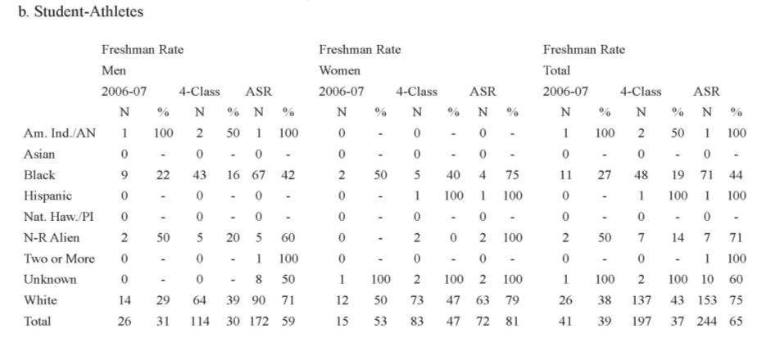
NCAA Retention Report

Slide 10
Methods and Results
.

Slide 11



Methods
Examined the 2006–2007 cohort
  Included all first-time freshmen for Summer 2006, Fall 2006 and Spring 2007 (full & part-time) (degree & non-degree seeking)
  All UNA transfer students between spring 2007 & spring 2013 who began their education at another institution during the 2006-2007 academic year
    (The National Student Clearinghouse was used to identify transfer students and their institution of origin and all subsequent institutions attended)
Package your presentation
for easy sharing

Slide 12

• Creation of an unduplicated list of undergraduate students from spring 2007 to spring 2013
• 22,814 students were sent to the NSC, including names and date of birth
• NSC matched this list with their dataset of all enrollment since 1994
• We received a file of 208,490 records from the NSC which included each institution attended, dates of attendance, name of college attended, and a 2-yr/4-yr indicator
• Of the 22,814 students sent to the NSC, 20,669 students were found in the NSC database and contained all necessary data
Identifying Transfer Students

Slide 13



Determining First Date of Attendance
The students with first date of attendance (identified by NSC) within the dates that constituted the 2006-2007 academic year were appended to the full cohort
  However, this process was complicated by Early Scholar students (those attending college courses while in high school)
  Therefore, high school graduation date (captured by UNA) had to be included to identify their first date of attendance AFTER HS graduation
After these additions the full cohort consisted of 1,829 students (1,163 freshmen and 666 transfer students) all beginning their post-secondary career in the academic year of 2006-2007

Slide 14
Results
Graduation rates comparison between 2006-07 academic year cohort and traditionally defined 2006 freshman cohort
 |  |  | Graduation Rates
 |  | N | 4 Year | 5 Year | 6 Year
Full Cohort | Freshmen | 1163 | 10.75% | 27.94% | 31.64%
 | Transfers | 666 | 4.65% | 16.67% | 24.47%
 | Total | 1829 | 8.53% | 23.84% | 29.03%
Traditional Freshman Cohort |  | 1019 | 10.99% | 27.87% | 32.29%

Slide 15
Results
Graduation rates comparison between the 2006-07 academic year cohort and traditionally defined 2006 freshman cohort, excluding transfer outs*
 |  |  | Graduation Rates
 |  | N | 4 Year | 5 Year | 6 Year
Full Cohort Excluding Transfer Outs | Freshmen | 765 | 16.34% | 42.48% | 48.10%
 | Transfers | 495 | 6.26% | 22.42% | 32.93%
 | Total | 1260 | 12.38% | 34.60% | 42.14%
Traditional Freshman Cohort Excluding Transfer Outs |  | 622 | 17.40% | 45.00% | 52.90%
*of the students who transferred out, 42.36% (n=241) transferred to 2-year institutions and 57.64% (n=328) transferred to 4-year institutions

Slide 16
Conclusions
It appears, for UNA, the federally defined way produces higher figures
Over half of the cohort, 57.86%, had not graduated by the sixth year, compared to 47% for the federally defined cohort
Transfers may be more likely to drop-out of college than first-time freshmen (6-yr grad rate for UNA’s federally defined cohort is 52.9%, compared to 32.93% for the transfers, excluding transfer outs for both groups)
  However, this could mean the transfer students are taking longer to graduate and are still enrolled
Given the demands placed upon an IR office this method does not yield sufficient results to justify the resources needed to complete such an intense analysis

Slide 17
Suggestions for Future Research
Evaluate credit hours brought to UNA by transfers
Analyze extended graduation rates 8, 10, 12 year
More in-depth statistical analyses evaluating differences between transfer graduation rates and the federally defined cohort’s rates
Evaluate the number of schools they’ve attended before UNA and look at trends in regards to time to graduation or drop-out rates
In-depth look at those who completely withdrew from college in an attempt to find similarities

Slide 18





Contact Information
Molly J. Vaughn, mjmathis@una.edu
W. Nathan Pitts, wnpitts@una.edu
PowerPoint location
http://www.una.edu/research/presentations-white-papers.html
University of North Alabama
Office of Institutional Research, Planning & Assessment
http://www.una.edu/research
Questions or Feedback?

